Slide 1
Battery SORTING Using a Robotic arm and yolov8
Faizan Mistry, Jithin Chandran, Megha Muralidharan

Slide 2
OBJECTIVE
This project explores automated battery differentiation using an Epson VT6 robot integrated with YOLOv8, a deep-learning object detection model. The system's objective is to enhance sorting efficiency in recycling and industrial settings by accurately categorizing AA, D, and 9V batteries in real time.

Slide 3
Introduction
Importance of Battery Sorting:
Battery recycling is crucial for environmental sustainability.
Manual sorting is inefficient and poses safety risks.
Role of Robotics and Deep Learning:
Robotics and deep learning can automate and optimize battery sorting processes.
The project aims to leverage these technologies for effective battery management.

Slide 4
Selection of Training Model
Why YOLOv8?
YOLOv8 is chosen for real-time object detection capabilities.
It handles multi-class detection and offers speed and accuracy improvements over previous versions.
Enhancements in YOLOv8:
Anchor-free approach for faster inference and improved processing speed.
Adaptive image scaling and anchor frame computation to enhance detection performance.

Slide 5
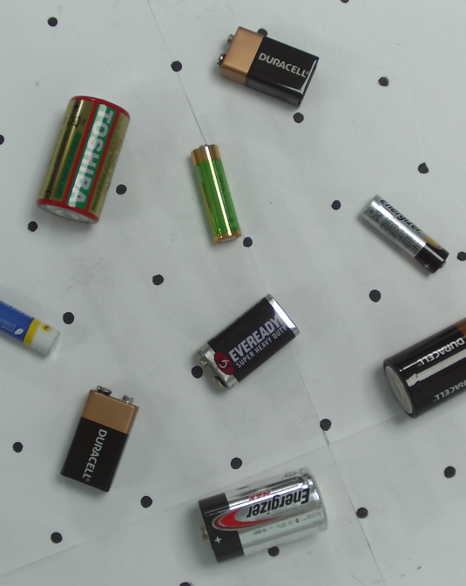
Data used
Training Dataset:
A total of 1581 images were used for training.
Each image contains up to 9 different batteries for diverse representation.
Validation Dataset:
194 images were used for validating the model during training.
Test Dataset:
109 new images utilized for independent evaluation, not part of training or validation sets.

Slide 6
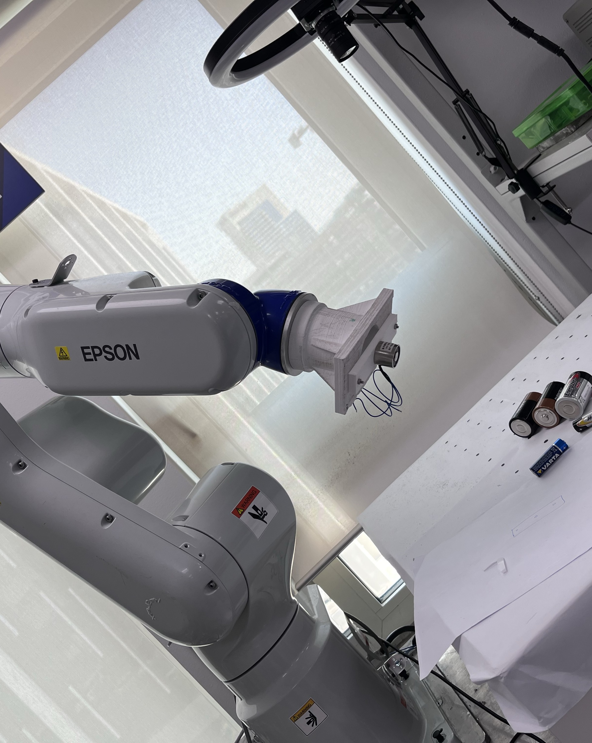
Robot and Robotic Arm Used
Epson VT6 Overview:
The Epson VT6 robot is designed for industrial applications with a 6 kg payload and high repeatability.
Integrated controllers enable precise motion and handling.
Electromagnetic Gripper:
The robotic arm utilizes an electromagnetic gripper for efficient battery handling.
Electromagnetic control allows instant adjustment of gripping force and enhances safety.

Slide 7
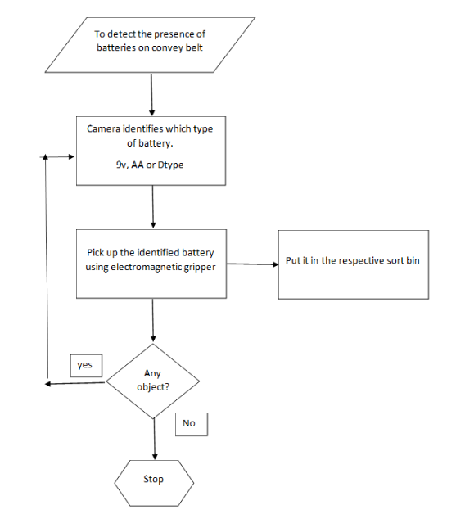
working

Slide 8
Testing and Performance Evaluation
The system was extensively tested under various conditions including different lighting types (natural, artificial, yellow), battery orientations (standing, lying down), and diverse backgrounds.
Testing included batteries from brands not in the training data and new battery orientations not encountered previously, demonstrating the system's adaptability.
The system demonstrated excellent performance in identifying and categorizing AA, D, and 9V batteries, even with batteries from new brands.
Experimentation involved adjusting camera distances.

Slide 9
Challenges faced during testing
Challenges included occasional difficulty in detecting AA batteries under natural lighting and rare confusion between 9V and D batteries of the same brand.
Proposed enhancements include introducing a confidence threshold to improve accuracy and mitigate misclassifications.
Implementing a confidence threshold and exploring additional enhancements for further accuracy and robustness.
The system achieved an 85% correct identification rate with high confidence, with misidentified batteries typically having lower confidence scores.

Slide 10
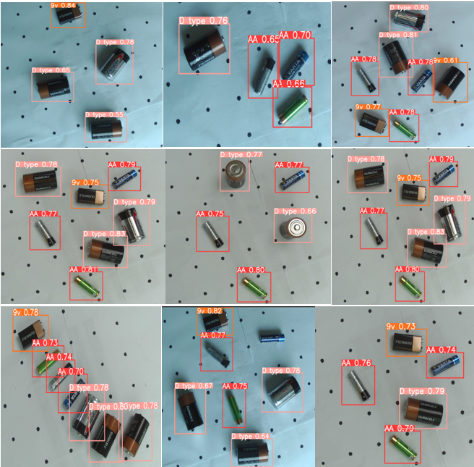
Test Results

Slide 11

Further Improvements
Optimizing Model Performance:
Strategies include data augmentation, regularization, and model complexity analysis.
Aim to bridge performance gaps and enhance model generalization for diverse scenarios.
Incorporating background images for better background detection and reducing false positives.
Fine-tuning YOLOv8 parameters to improve confidence scores and classification accuracy.

Slide 12
Conclusion
Project Outcomes:
Successful integration of robotics and deep learning for battery differentiation.
Demonstrates potential for industrial-scale application in recycling and resource recovery.
Future Prospects:
Envisions broader applications beyond battery sorting in recycling plants and industrial automation.
Highlights scalability and adaptability for diverse environmental conditions.

Slide 13
Future Use:
Scaling the Technology:
Expanding the system's capabilities for large-scale battery recycling operations.
Exploring applications in sorting other electronic waste categories.
Research Directions:
Investigating advanced deep learning techniques and robotic systems for enhanced automation.

Slide 14
THANK YOU
https://github.com/mfaizan44/Robotic-arm-sorting-out-batteries

